Slide 1


SMART INDIA HACKATHON 2024
Problem Statement ID - 1596
Problem Statement Title – Student Innovation (Developing solutions, keeping in mind the need to enhance the primary sector of India - Agriculture and to manage and process our agriculture produce)
Theme: Agriculture, foodtech and Farmers welfare
PS Category - Software
Team ID -
Team Name - CodeCultivators

Slide 2
Solution
CodeCultivators
Proposed Solution (Describe your Idea/Solution/Prototype)
1. Market Access Challenges: Farmers often struggle to access markets directly and are dependent on middlemen, which reduces their income.
2. Solution Overview: Develop a mobile app that directly connects farmers with consumers and Retailers.
3. Produce Listing Feature: The app allows farmers to list their produce with detailed information.
4. Price Negotiation and Transaction Management: The app facilitates direct price negotiation and secure transaction management.
5. Expected Outcomes: Increased farmer income, fairer pricing, better market access, and more efficient transactions.
@SIH Idea submission- Template

Slide 3
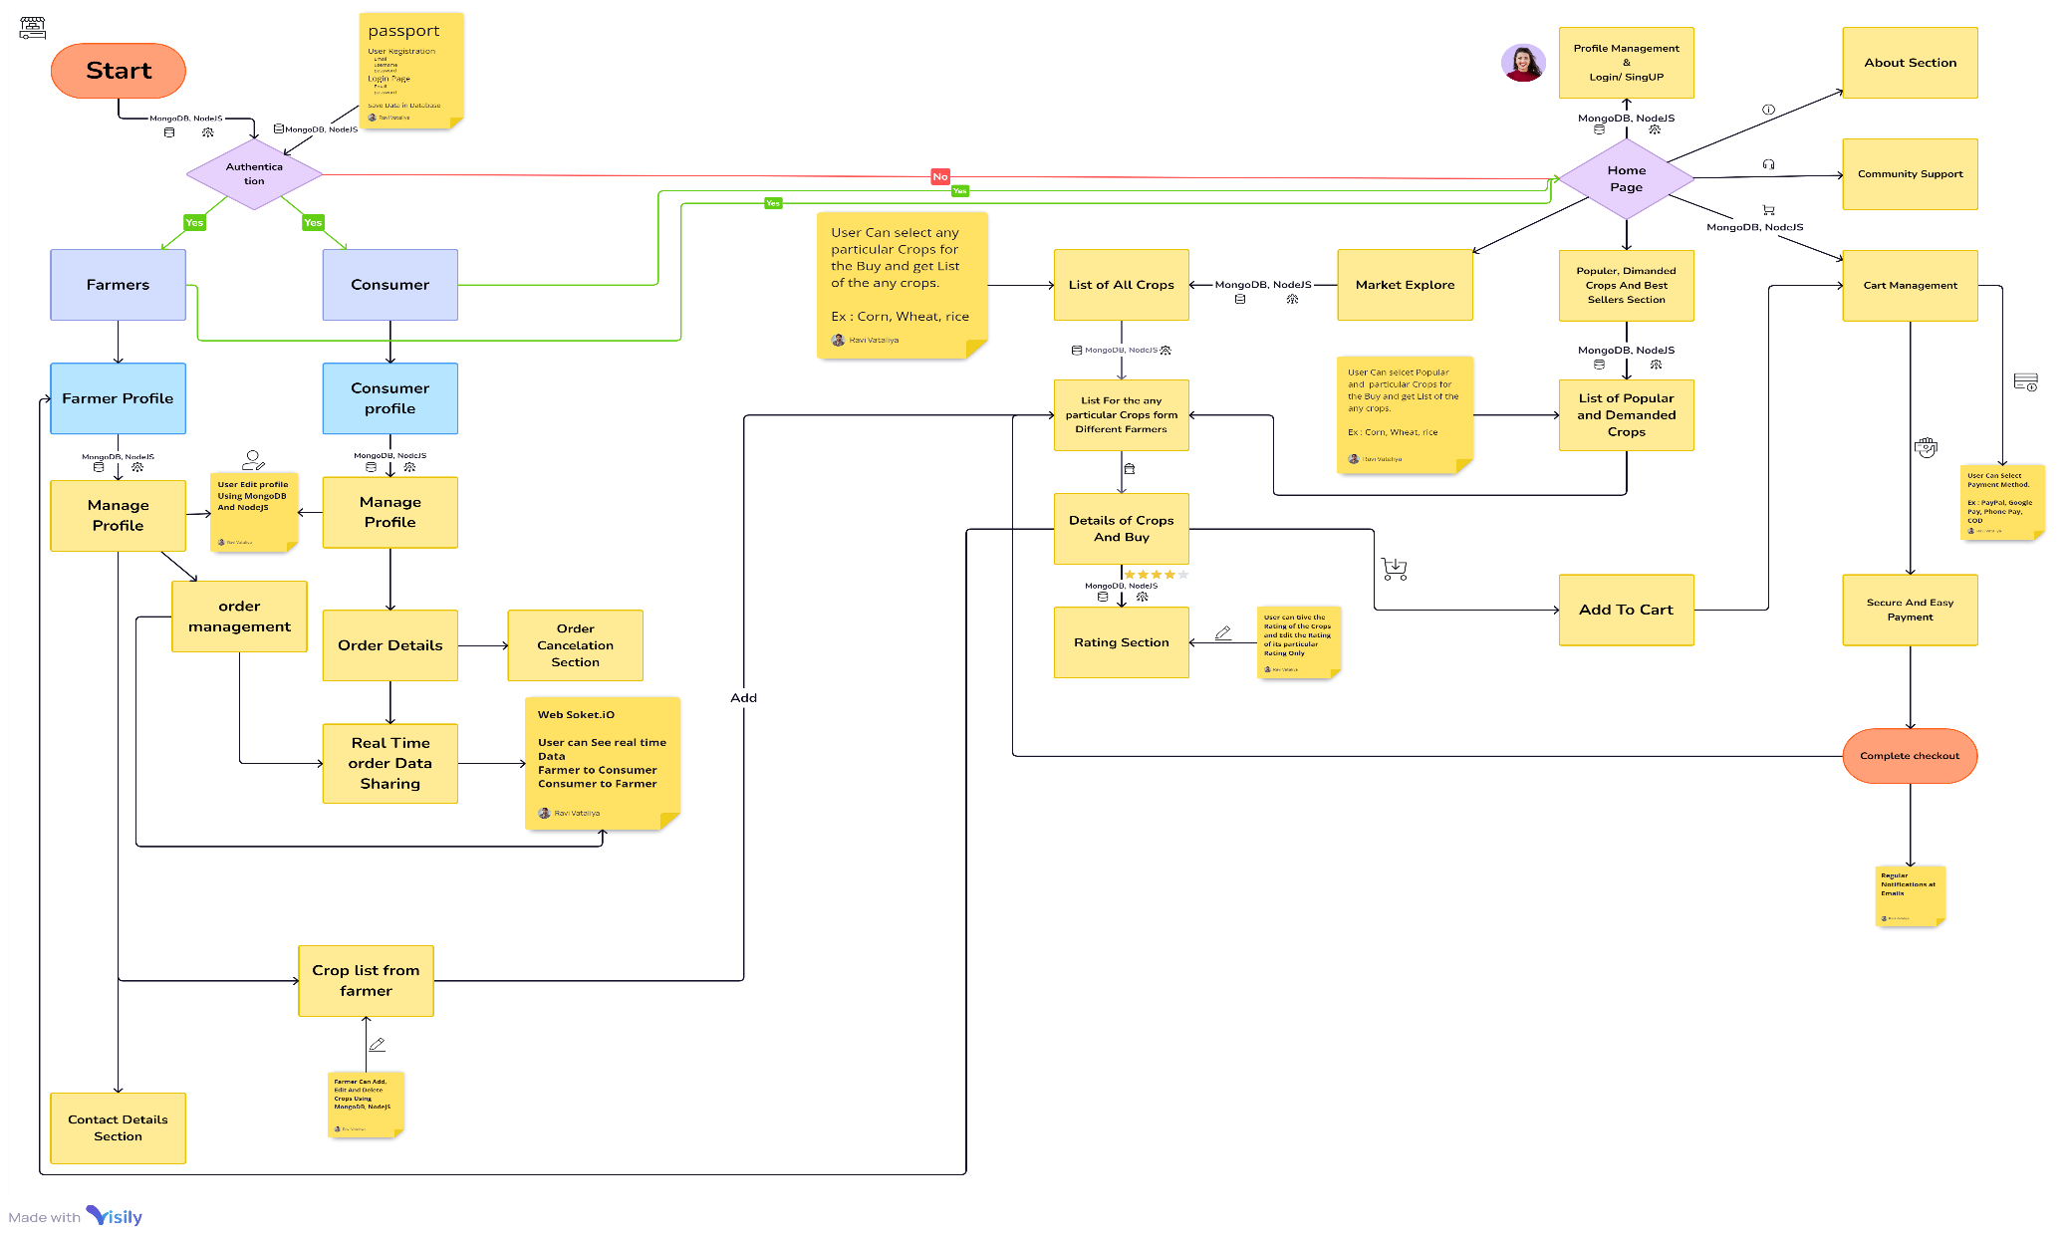
TECHNICAL APPROACH
CodeCultivators
Technology Use :
Ejs
Javascript
Css
NodeJs
ExpressJs
MongoDB
Websoket.io
React Native
@SIH Idea submission- Template

Slide 4
FEASIBILITY AND VIABILITY
CodeCultivators
Analysis of Feasibility and Challenges:
Feasibility: The app idea is feasible but faces certain challenges.
Digital Literacy: Many farmers may lack the digital skills needed to use the app effectively.
Infrastructure Limitations: Reliable internet access and necessary infrastructure may be lacking in rural areas.
Trust-Building: Establishing trust between buyers and sellers is crucial for the app’s success.
Risk Mitigation: Overcoming these challenges involves providing user training, improving internet access, and implementing a strong feedback system to build credibility and trust.
@SIH Idea submission- Template

Slide 5
IMPACT AND BENEFITS
CodeCultivators
Potential Impact and Benefits:
Income Improvement: The app can significantly increase farmers' income by eliminating middlemen.
Fair Pricing: Farmers receive fairer prices for their produce through direct sales.
Market Expansion: The app expands market access for farmers, reaching a broader audience.
Social and Economic Impact: The solution empowers farmers with direct control over sales, leading to higher profits.
Environmental and Community Benefits: By optimizing supply chains, the app reduces waste and enhances transparency and economic resilience for farming communities.
@SIH Idea submission- Template

Slide 6
RESEARCH AND REFERENCES
CodeCultivators
research And Refrence –
Chat GPT
Blogs LINK
You Tube LINK
@SIH Idea submission- Template

Slide 7
Team Details
CodeCultivators
Team leader: Gohil Mitalba
Email: gohilmittalbaj47@gmail.com@gmail.com
Members -
Ghervara tanisha || Email: ghervaratanisha@gmail.com
KAVANKUMAR PATEL || Email: kavanpatel3421@gmail.com
Vataliya Ravi Ghanshyambhai || EMAIL: vataliyag174@gmail.com
Patel Shivam Jayeshbhai || Email - shivamjpatel1206@gmail.com
Dhyey Sutariya || e-mail - optimisticdhyey@gmail.com
@SIH Idea submission- Template

